Slide 1

TEEGALA KRISHNA REDDY ENGINEERING COLLEGE
(Approved By AICTE , Affiliated To JNTUH, Accredited By NBA And NAAC)
DEPARTMENT OF COMPUTER SCIENCE & ENGINEERING
HEAD OF THE DEPARTMENT:
Dr. CH. V. PHANI KRISHNA
PROFESSOR
PROJECT CO-ORDINATOR:
Mrs. A. MOUNIKA
ASSISTANT PROFESSOR

Slide 2
AI-Powered Automated Attendance System
SUPERVISOR:
MRS.P.SWETHA
ASSISTANT PROFESSOR
TEAM MEMBERS:
M.NITHISH KUMAR-23R91A05L6
P.RAHUL-23R91A05P1
P.HARSHITHA-23R91A05Q2
R.CHARAN KUMAR-23R91A05R2

Slide 3
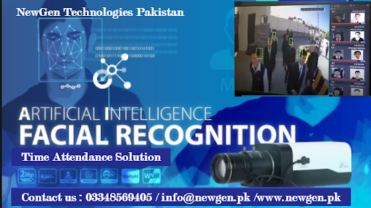
CONTENTS:
ABSTRACT
INTRODUCTION
EXISTING SYSTEM
PROPOSED SYSTEM
SYSTEM SPECIFICATIONS
SYSTEM ARCHITECTURE
MODULES
UML DIAGRAMS
Conclusion
Reference

Slide 4
ABSTRACT:
In the evolving landscape of digital education, efficient attendance management remains a critical challenge. Traditional attendance systems, often relying on manual roll calls or basic electronic methods, suffer from inefficiencies, inaccuracies, and vulnerabilities to misuse such as proxy attendance. As educational institutions grow larger and more complex, there is an increasing need for automated, reliable, and secure attendance solutions. An effective system should minimize manual intervention while ensuring accuracy, real-time monitoring, and ease of data management. The proposed AI-Powered Automated Attendance System leverages CCTV cameras combined with advanced computer vision and deep learning techniques to automatically detect and recognize student faces in real time. This approach eliminates manual errors, reduces administrative workload, and prevents fraudulent attendance practices. By integrating intelligent face recognition algorithms with a centralized database, the system offers seamless attendance tracking, efficient data storage, and easy accessibility for faculty and administrators. As educational environments continue to modernize, this solution is well-equipped to meet growing demands, providing a scalable, secure, and forward-thinking attendance management system.

Slide 5
INTRODUCTION:
In an era driven by automation and artificial intelligence, educational institutions continue to face the administrative burden of manually tracking student presence. Traditional methods are not only time-consuming but are frequently compromised by proxy attendance and human error. To bridge this technological gap, we introduce the AI-Powered Automated Attendance System. This project leverages state-of-the-art Computer Vision and Deep Learning algorithms to seamlessly identify students in real-time through classroom camera feeds. By completely eliminating physical interaction and manual roll calls, this system transforms attendance from a tedious administrative task into an invisible, highly accurate, and secure background process. It is designed to empower faculty, maintain absolute academic integrity, and modernize the educational ecosystem.

Slide 6
EXISTING SYSTEM:
The existing attendance system mainly relies on manual roll calls, paper-based registers, or basic electronic systems such as RFID cards and biometric scanners. These systems require physical interaction, causing delays and crowding during attendance marking. Proxy attendance remains a common issue due to card sharing or fingerprint manipulation. Additionally, these systems lack real-time monitoring and automated verification, making it difficult to detect fraudulent attendance. Managing attendance records manually or with limited automation is cumbersome, especially for large classrooms, resulting in inefficiency and errors
Drawbacks:
Manual Process: Requires teachers to call out names or students to sign registers, consuming valuable class time.
Physical Interaction: Students must use cards or biometric devices, causing delays and queues.
Proxy Attendance: Card sharing and fingerprint spoofing allow dishonest attendance marking.
No Real-Time Monitoring: Lack of continuous verification and supervision during attendance.
Inefficient Record Management: Manual or semi-automated record keeping is error-prone and hard to analyze.
Low Scalability: Difficult to implement effectively in large classrooms or institutions.

Slide 7
PROPOSED SYSTEM:
The proposed system introduces an AI-powered automated attendance solution using CCTV cameras and facial recognition technology. Classroom cameras capture real-time video, and AI algorithms detect and recognize student faces automatically. Attendance is marked instantly and stored securely in a centralized digital database, eliminating manual intervention. The system prevents proxy attendance by verifying identities continuously, enhances accuracy, and allows easy access to attendance records and reports for faculty and administrators. Built with Python and OpenCV for face recognition, Flask/Django backend, React.js frontend, and MySQL/MongoDB for data storage, the system is scalable, efficient, and secure.
Advantages:
Automated Attendance: Eliminates manual roll calls, saving classroom time.
Contactless Identification: Uses facial recognition without physical interaction.
Proxy Prevention: Detects and prevents proxy attendance in real time.
Continuous Monitoring: Ensures students remain present during sessions.
Accurate Record Keeping: Automatically updates and manages attendance data securely.
Easy Access & Reporting: Provides intuitive interfaces for faculty and admins to review attendance.
Scalable & Secure: Suitable for small to large educational institutions with strong data protection.

Slide 8
SYSTEM SPECIFICATIONS:
Hardware Requirements
• Processor: Intel Core i5 (8th Gen) / AMD Ryzen 5 or higher
• RAM: Minimum 8 GB (16 GB recommended for AI processing)
• Storage: 256 GB SSD (for fast database and image retrieval)
• Camera: Standard 720p/1080p HD Webcam or IP CCTV Camera
2. Software Requirements
• Operating System: Windows 10/11, macOS, or Linux (Ubuntu)
• Programming Language: Python 3.10+
• Web Technologies: HTML5, CSS3, JavaScript (React.js)
• Framework: Flask (Python Backend)
3. AI & Deep Learning Stack
• Core AI Environment: TensorFlow & Keras
• Computer Vision Library: OpenCV (Open Source Computer Vision)
• Face Recognition: dlib, face_recognition API
4. Database Management
• Runtime Database: SQLite 3 (Central Attendance Records)
• Vector Storage: Pickle (.pkl) for serialized face embeddings

Slide 9
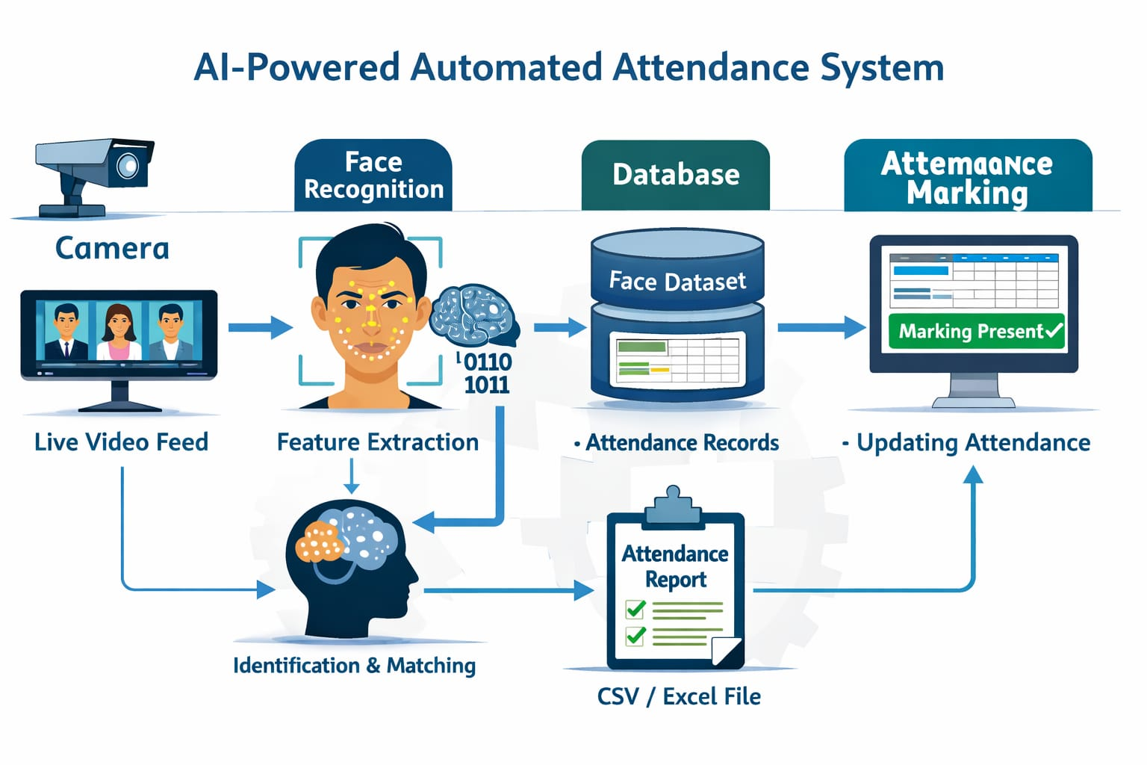
SYSTEM ARCHITECTURE:

Slide 10
MODULES:
1. Admin/Faculty Module
Manage student enrolment databases
Configure 60-minute class periods and 10-
minute grace rules
Mark manual attendance overrides
Monitor real-time classroom statistics
2. Student Module
Student login and profile update
Register facial data for AI recognition
View personal attendance percentages
Access historical attendance records
3. Camera & Capture Module
• Continuous real-time video stream processing
• Automated frame extraction during active periods
• Secure face isolation and ROI cropping
4. AI Recognition Engine Module
• Automatically detect faces in dynamic classroom
environments
• Generate and compare deep-learning face embeddings
• Calculate matching confidence scores against the
database
5. Smart Logic & Processing Module
• Enforce strict 60-minute period and time-barrier logic
• Process grace-period exceptions for late arrivals
• Finalize present/absent status automatically
6. Notification & Reports Module
• Trigger SMS/WhatsApp alerts for proxy flags or
absences
• Generate granular class attendance analytics
• Export final attendance logs for academic records

Slide 11
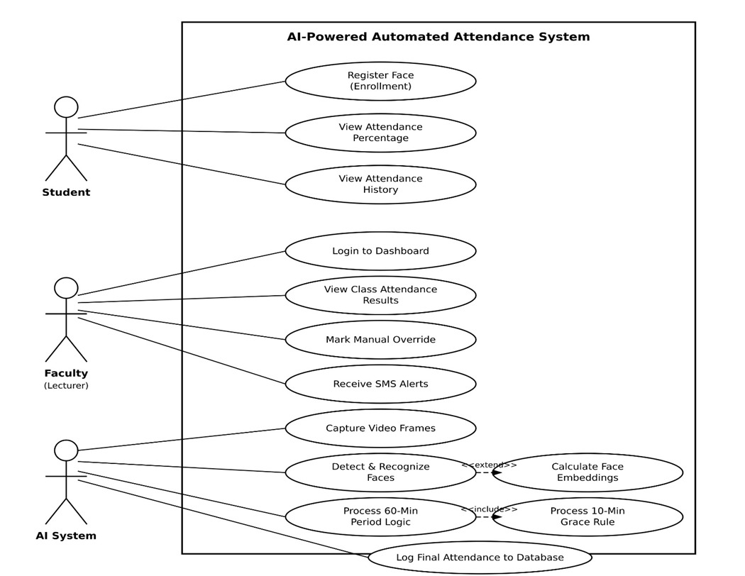
UML DIAGRAMS:
Use-Case diagram:

Slide 12
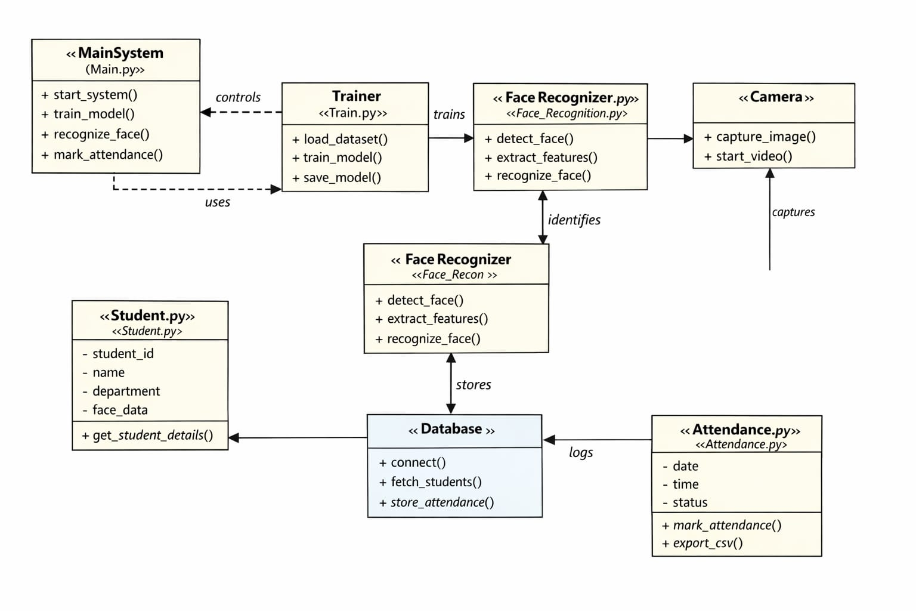
Class diagram:

Slide 13
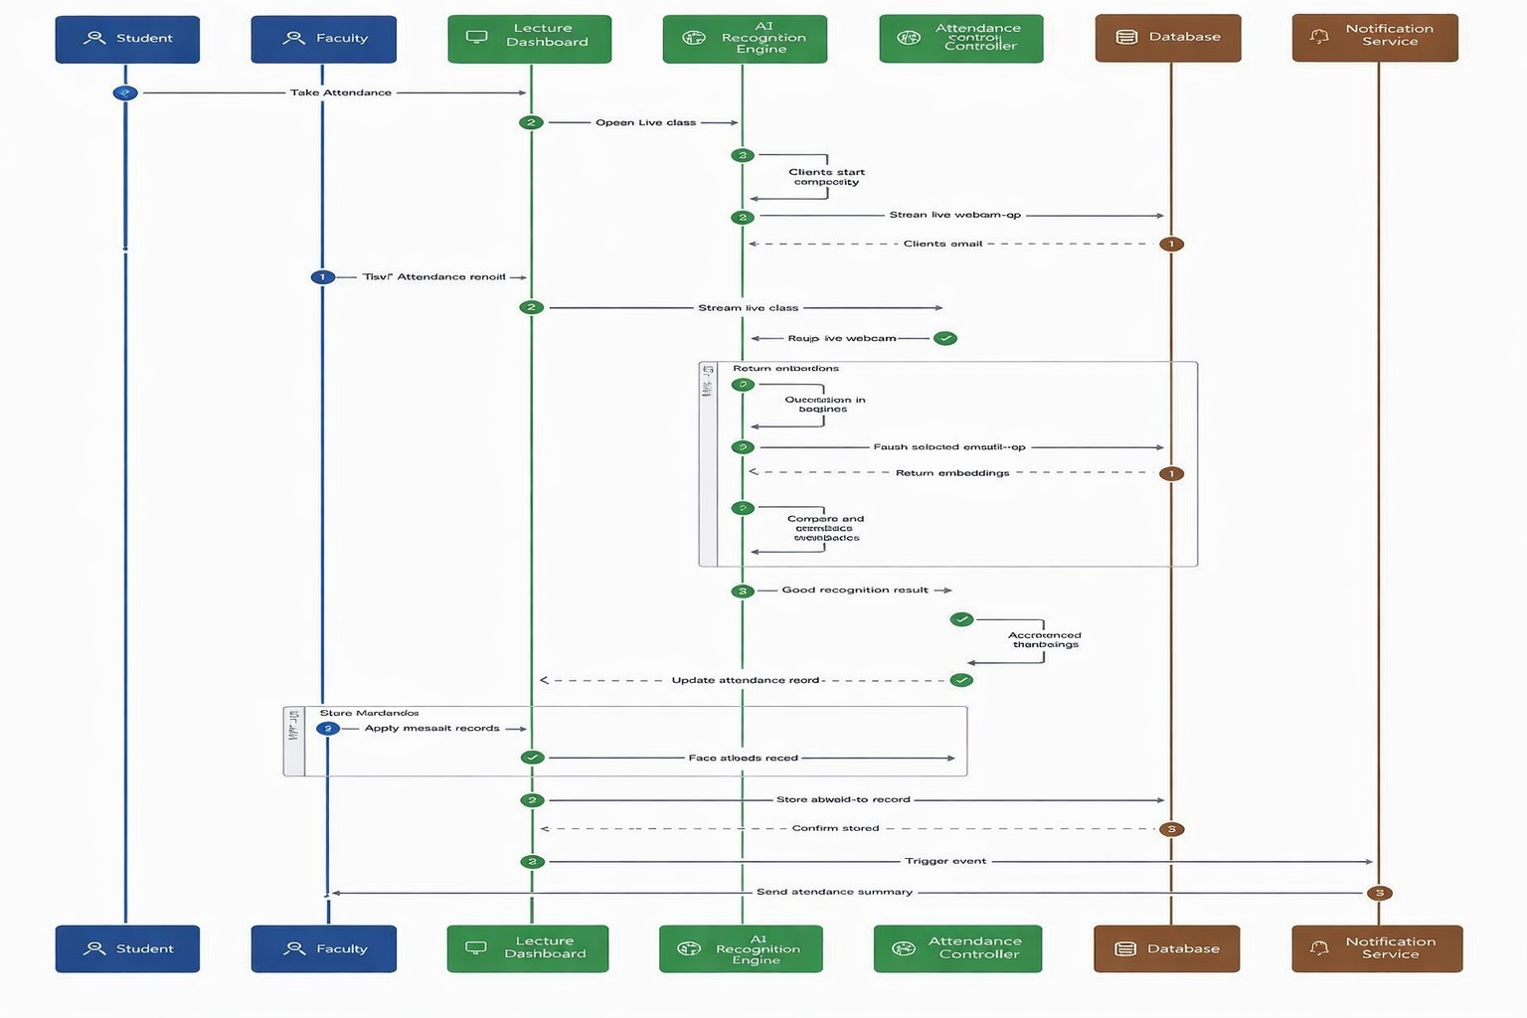
Sequence diagram:

Slide 14
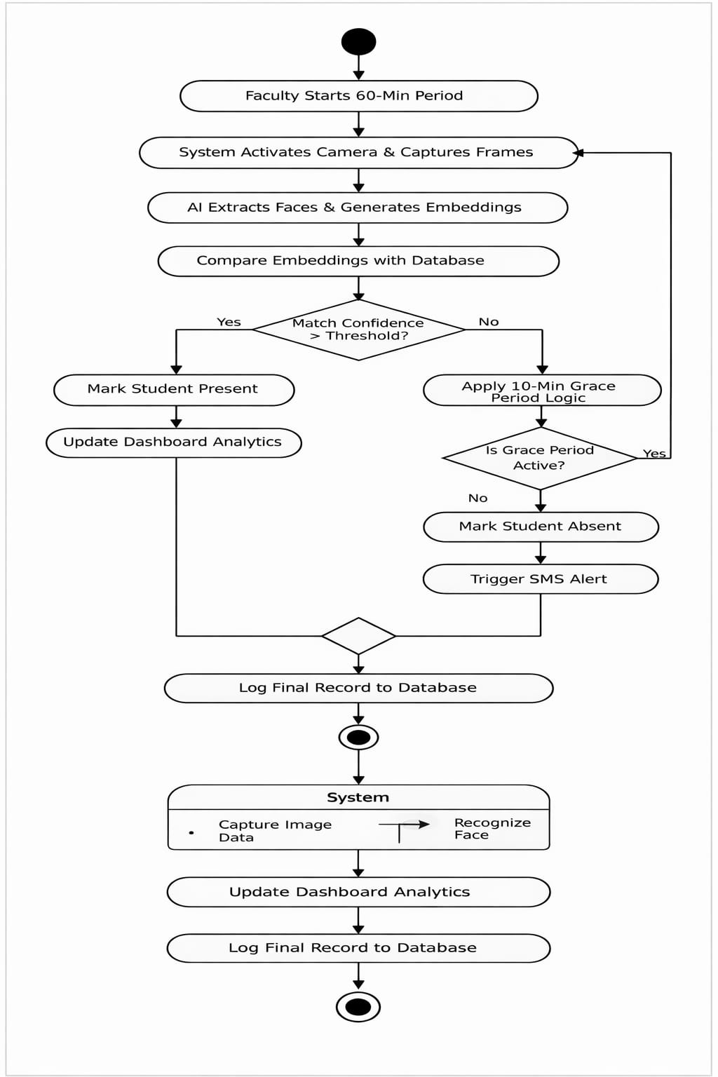
Activity diagram:

Slide 15
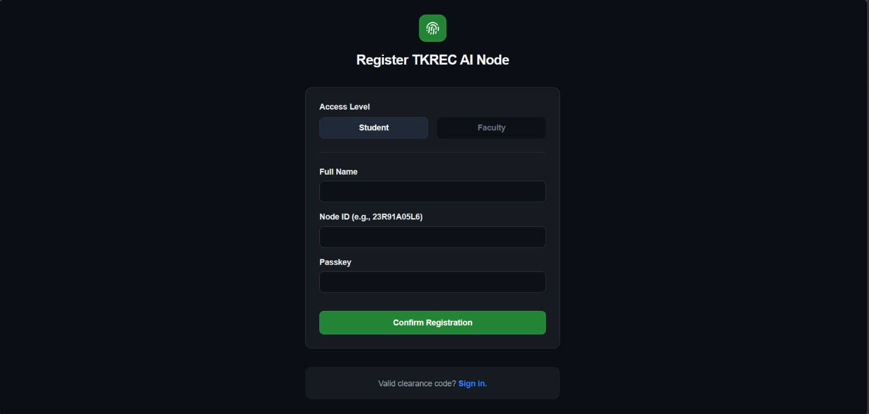
OUTPUT SCREENS:
Register Page:

Slide 16
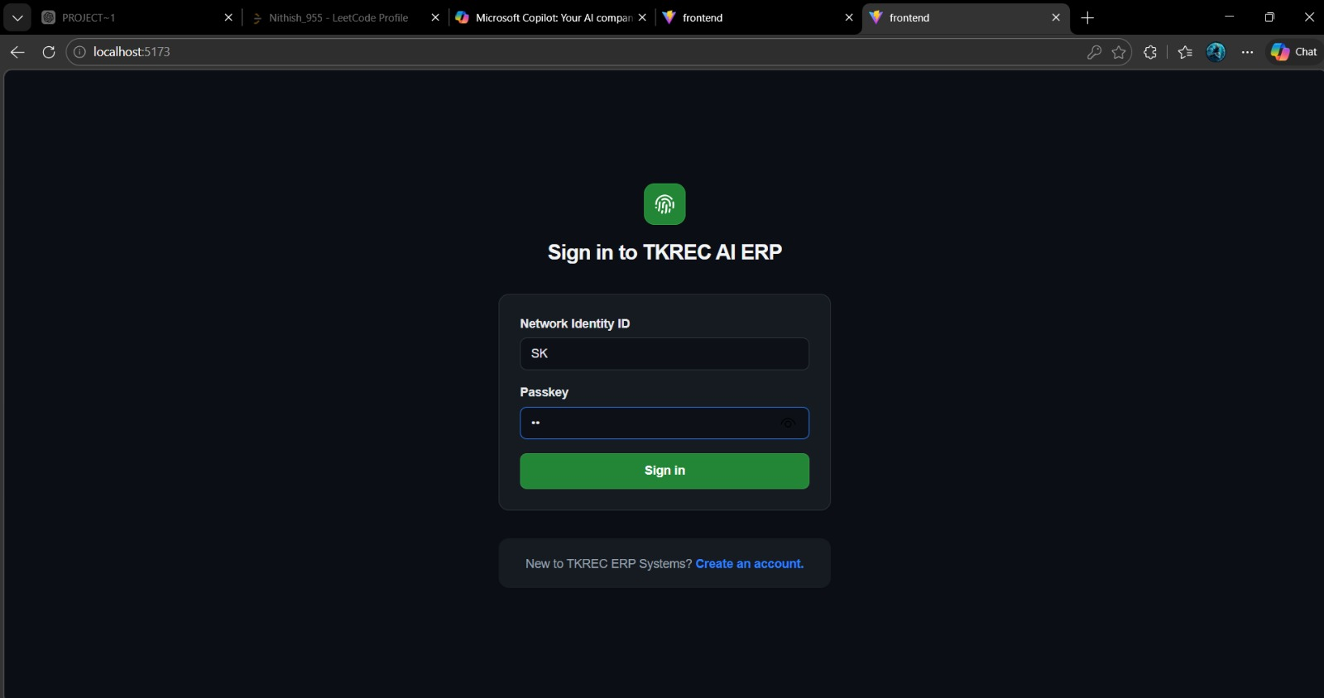
Login Page:

Slide 17
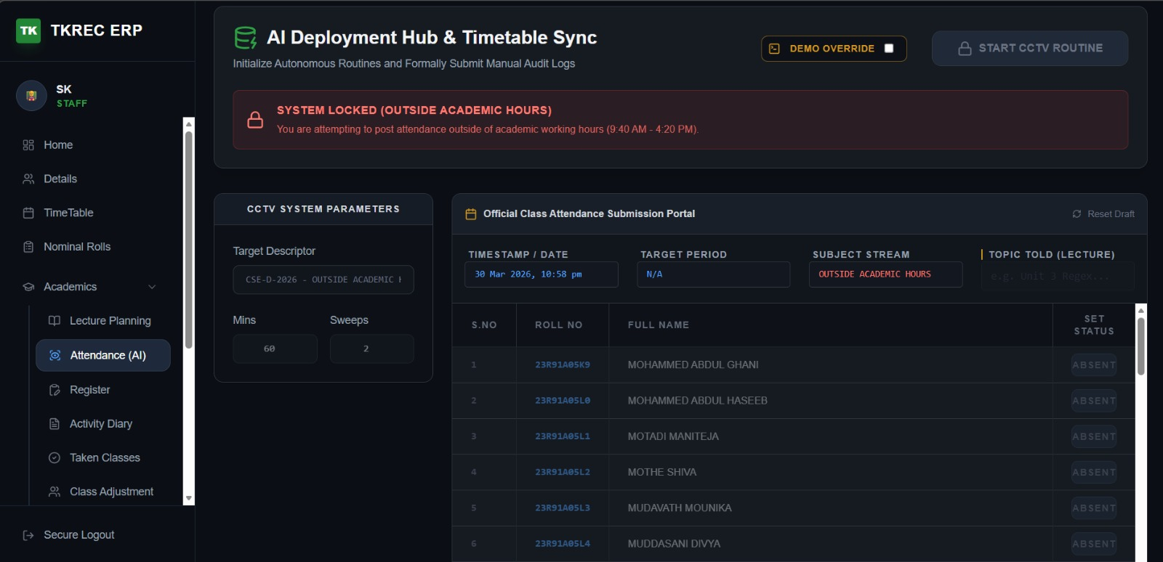
Attendance Page:

Slide 18
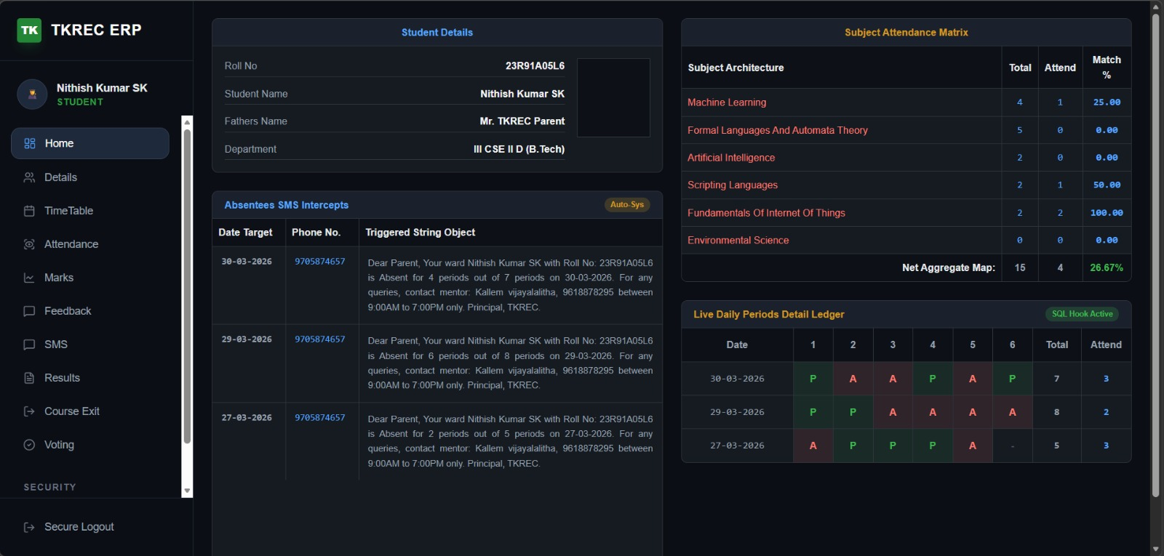
Student Dashboard Page:

Slide 19
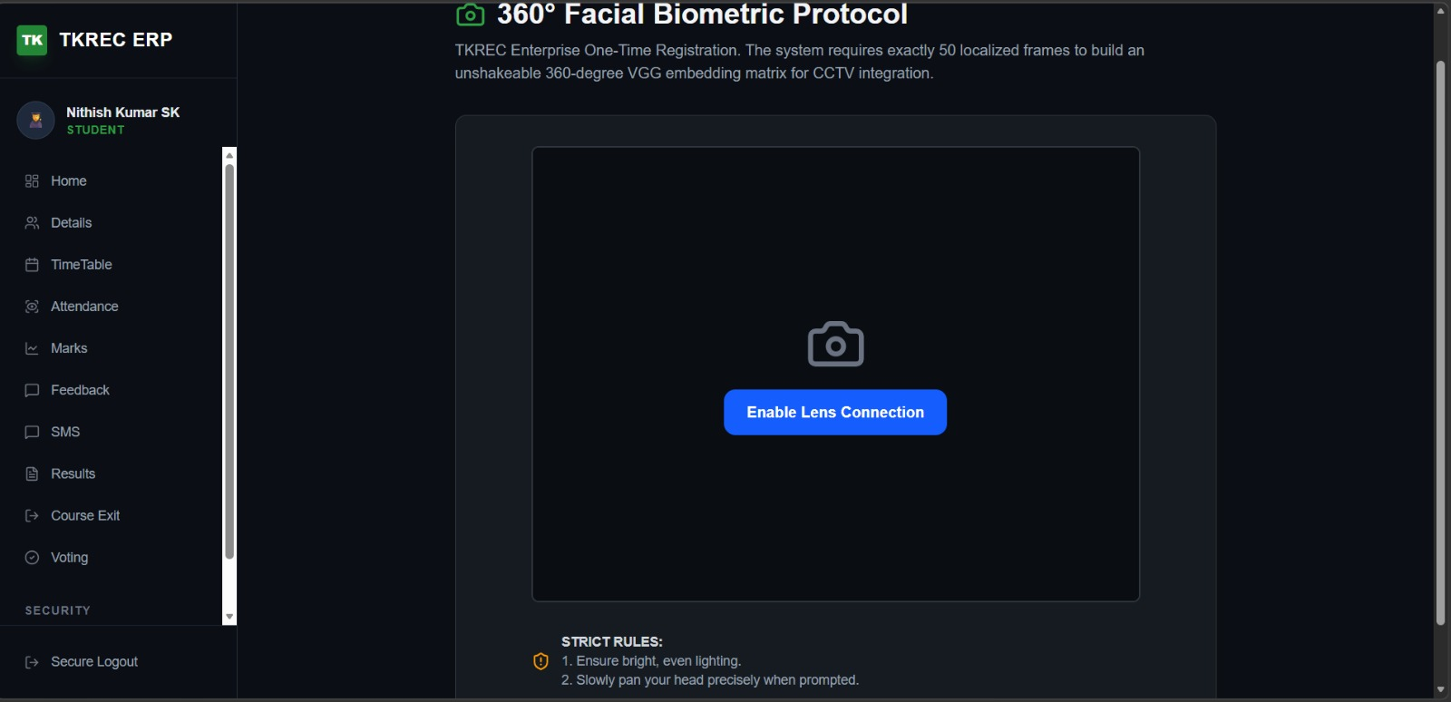
Face Capturing & Model Training Page:

Slide 20
CONCLUSION:
The AI-Powered Automated Attendance System represents a definitive technological leap in modern campus infrastructure, successfully eliminating the inefficiencies of manual roll calls through a continuous, high-precision deep learning pipeline. By seamlessly synchronizing a strict physical timetable with an automated SMS notification architecture, the system enforces uncompromised academic tracking and real-time institutional oversight. Advanced hardware anti-spoofing measures and rigorous mathematical confidence protocols work in tandem to completely eradicate traditional proxy attendance, structurally securing a pristine, immutable ledger of student activity. Ultimately, this highly robust and scalable architecture proves that an intelligent, frictionless computer-vision solution can be flawlessly deployed in live academic environments—drastically reducing administrative overhead while establishing a new gold standard for absolute accountability and operational excellence.

Slide 21
REFERNCES:
[1] A. Kumar and J. S. Prasad, “Automated Student Attendance System Using Facial Recognition and Deep Learning,” International Journal of Computer Applications, vol. 182, no. 15, pp. 21–27, Oct. 2021.
[2] R. Sharma and P. Gupta, “Real-Time Face Detection and Attendance Management System Using OpenCV,” International Journal of Recent Technology and Engineering, vol. 9, no. 2, pp. 1150–1155, Jul. 2022.
[3] M. T. Hossain, M. R. Karim, and S. Ahmed, “An Intelligent Attendance System Using Convolutional Neural Networks,” in Proc. IEEE Int. Conf. Computer and Information Technology, Dhaka, Bangladesh, 2020, pp. 88–93.

Slide 22
THANK YOU

